Slide 1
Couchbase - Sitting on RDBMS since 2010
Corbin Matamoros & Matthew Stanley
5303 Adv. Database Management Systems – Dr. T. Griffin

Slide 2
Table of Contents
History of Couchbase
Relation vs. Non-relational Databases
So what is Couchbase?
Why NoSQL?
N1QL
Example N1QL Query
Implementation Languages
Storage
Buckets
VBuckets (Sharding)
Examples
Couchbase Security
Authentication
Authorization
Auditing
Encryption
Multidimensional Scaling
Couchbase demonstration
Questions

Slide 3




History of Couchbase
In 2011, two NoSQL companies Membase(formerly Northscale) and CouchOne decided to form together in order to create a new database.
The result was a database that implemented the features of both companies' databases called Couchbase.
=
Notes:
Membase focused on scalability, performance, and using a server to the most of its potential.
CouchDB focused on mobile, sync and offline uses. They wanted more reliability and accessibility.

Slide 4
Relational vs. non-Relational
Relational database
Stored data is related to each other in some way
The use of tables provides an intuitive method to store and access structured info
Data is accessed in a secure, rules-based, consistent way
NOTE: By consistent, we mean data is kept consistent across all instances
Possesses atomicity, a multifaceted commitment capability
Allows function storing for more efficient querying
Implements locking and concurrency
Non-relational database
Storage model is optimized for a specific type of data (JSON documents, key/value pairs, or graphs)
Consistency is compromised, as most NoSQL stores lack true ACID transactions
Eventual consistency: data is written across all nodes “eventually”
Schema design for handling relational data
Nested data: Data can be organized into subsections/collections
Multiple queries: perform multiple queries to retrieve desired data
Storing extras: Instead of just storing foreign keys, store actual foreign values along with model data
Notes:
https://www.oracle.com/database/what-is-a-relational-database/
Atomicity: a database won’t commit for one part unless it knows it can commit for all parts
Atomicity Example from website above: For example, consider an inventory database that tracks three parts that are always used together. When one part is pulled from inventory, the other two must also be pulled. If one of the three parts isn’t available, none of the parts should be pulled—all three parts must be available before the database makes any commitment. A relational database won’t commit for one part until it knows it can commit for all three.
Locking: prevents other users and applications from accessing data while it is being updated
Concurrency: manages the activity when multiple users or applications invoke queries simultaneously on the same database
----------------------------------------------------------------------------
https://docs.microsoft.com/en-us/azure/architecture/data-guide/big-data/non-relational-data
https://en.wikipedia.org/wiki/NoSQL

Slide 5
So what is Couchbase?
Couchbase is an open-source NoSQL (non-relational) document-oriented database
Data is stored as a document, formatted in JSON
Data is manipulated with a SQL-like query language, N1QL (pronounced nickel).
NOTE: N1QL supports nested attributes and domain-oriented normalization
Couchbase is consistent and partition tolerant
Consistent: all reads receive the most recent write (or an error otherwise)
Partition tolerant: A network can be divided into subnets, allowing a system to continue operating despite others failing
Servers are managed by a cluster manager using Erlang and the Open Telecom Platform
Notes:
https://en.wikipedia.org/wiki/Couchbase_Server
https://www.guru99.com/database-normalization.html: Normalization is a database design technique which organizes tables in a manner that reduces redundancy and dependency of data.

Slide 6
So what about Couchbase?
Couchbase is a document data store
Document: a set of string fields and object data values in an entity
Data is managed through the fields (searching/modifying)
Documents need not be identically formatted
Documents are assigned a unique identifier, the key
Reads and writes over multiple fields in a single document are typically atomic

Slide 7
Why NoSQL?
Scalability
Relational DBs need hardware mods to expand
In NoSQL, all we need are more servers
Agile development
Relational databases data models are fixed
In NoSQL, the developer creates the data model for their needs
Faster reads – relational DBs require “shredding” to read data
Data replication, partitioning, and redundancy
Data is distributed and partitioned to multiple database instances
Node failure does NOT injure the data or data transmission process
Data replication is automatic and could be bidirectional
Notes:
https://www.couchbase.com/resources/why-nosql

Slide 8
Implementation Languages
Couchbase is written using a collection of languages
C and C++
Data handling, like RAM cache, partitioning, and persistence management
Erlang
Server/cluster manage
Distribution parts
Chosen mainly for its built in support of concurrency, which helps prevent deadlock.
Go
N1QL and other parts of Couchbase

Slide 9
Nodes and Clusters
Nodes: a Couchbase "node" is a physical or virtual machine that hosts a single instance of Couchbase.
Only one instance of Couchbase may be initialized on each node.
Cluster: a "cluster" consists of one or more nodes that is running Couchbase.
Data and services are exchanged between the nodes in the cluster to ensure high availability.
It may be expanded by adding new nodes or joining with another

Slide 10
Storage
Data in Couchbase is stored as formatted JSON files, also called items or documents.
Each document in Couchbase consists of an id and its key value pairs
Items in Couchbase are stored in "Buckets" which will group items by their keys logically

Slide 11
Buckets
Couchbase provides users with three types of buckets:
Couchbase Buckets – store data persistently, as well as in memory.
If bucket exceeds memory capacity, items are ejected
Ephemeral Buckets – useful when persistence is not required.
Faster than other buckets
If bucket exceeds memory capacity, items are ejected and attempts to add fail
Memcached Buckets – designed to be used alongside other database platforms.
These buckets are not persistent on disk, and only exist in RAM.
If items are ejected in this bucket, they cannot be reacquired from Couchbase Server.
These buckets also do not support replication.
Notes:
Couchbase buckets: If the amount of memory a bucket may hold is exceeded, the items are ejected. This means they are removed from memory, but not from disk.
Ephemeral Buckets: Faster than the other buckets, and allows faster node rebalances and restarts. If an ephemeral bucket is unable to hold any more data, attempts to add more data will fail or items within the bucket will be ejected. While ejection will remove an item's data, a record of the item (called a tombstone) is kept.
Memcached buckets: designed to be used alongside other database platforms, such as ones using relational database technology. These buckets are not persistent on disk, and only exist in RAM. If items are ejected in this bucket, they cannot be reacquired from Couchbase Server. These buckets also do not support replication.

Slide 12
VBuckets (Sharding)
Couchbase implements automatic sharding through the use of "vBuckets".
Couchbase and Ephemeral buckets are broken down into 1024 pieces (64 on MacOS) which are known as vBuckets or shards.
These vBuckets are distributed evenly across the nodes of a cluster through hashing and the use of a cluster map to tell Couchbase where each vBucket should go.
If a new node is added to the cluster, the cluster map is updated accordingly, and the vBuckets are automatically shared with the new node.
Sharding makes data much faster to access and makes maintaining a large database easier since the data is spread out.
Notes:
The algorithm used in creating the Hash table is a CRC32 hashing algorithm, which is applied to each item's key.

Slide 13
N1QL
N1QL (pronounced "nickel") is Couchbase's query language, which is similar in syntax to SQL.
A basic N1QL query is comprised of three basic parts:
SELECT – What you want to return from a document. Can specify with keys.
FROM – The bucket where you want to look. The bucket's name must be enclosed within Backwards quotes. Example: `Bucket-Name`.
WHERE - Conditions that the document must satisfy.
The result of a N1QL query will be another document containing the requested information.

Slide 14
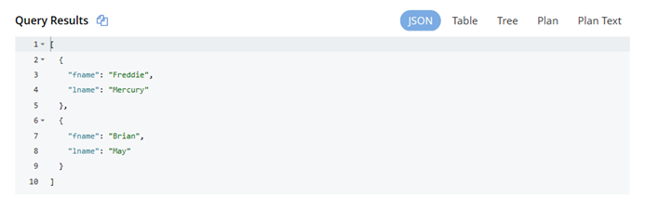
Example N1QL Query
SELECT fname, lname FROM `Musicians` WHERE Band = 'Queen' LIMIT 2

Slide 15
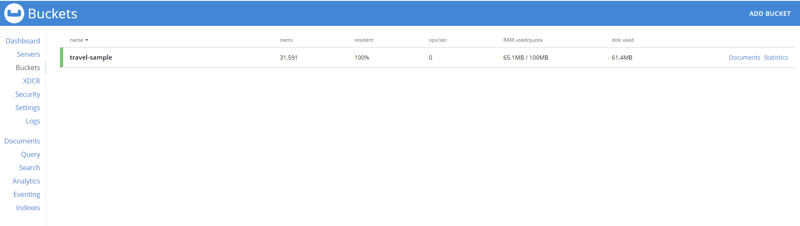
List of Buckets on Sample Machine

Slide 16
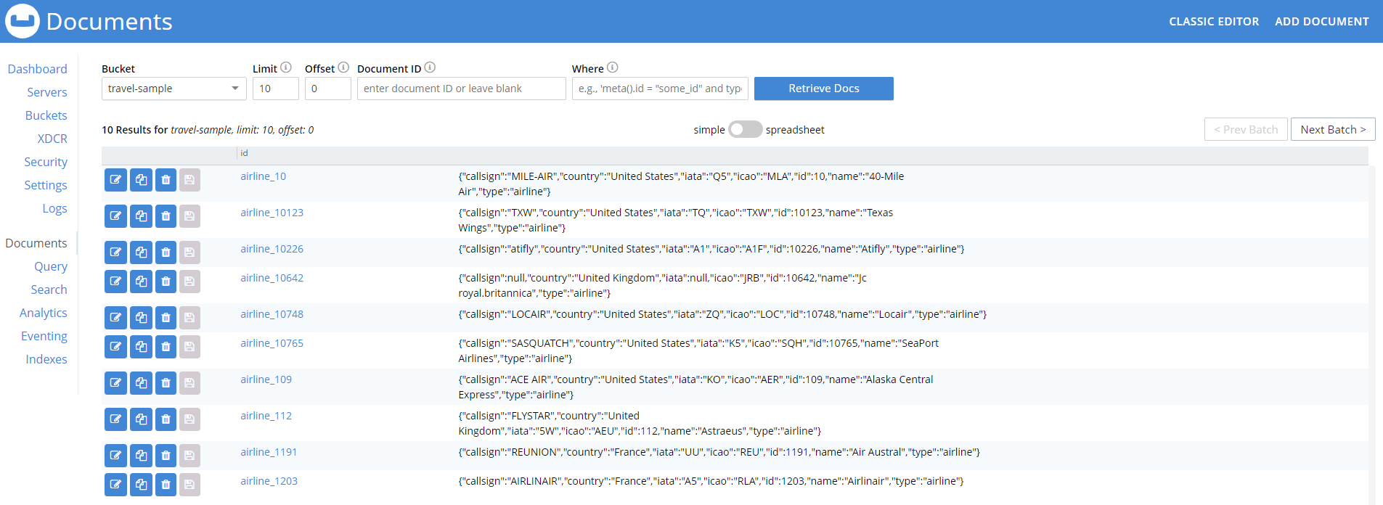
List of Documents within a Bucket

Slide 17
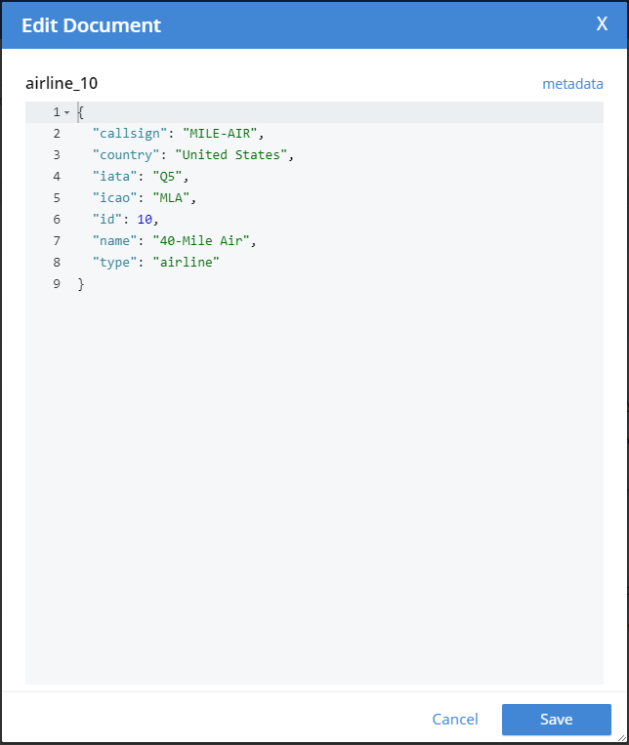
We can edit a document directly

Slide 18
Couchbase Security - Authentication
Authentication
The forms of credentials
Privileges
Passing credentials
PLAIN
SCRAM-SHA1
SCRAM-SHA256
SCRAM-SHA512
Notes:
https://docs.couchbase.com/server/6.0/learn/security/security-overview.html
Authentication relies on credentials. Credentials must match the ones in the system. If they do, access is granted. In Couchbase Server, users submit a username and password. If on Linux, one can use LDAP (Lightweight Directory Access Protocol) or PAM (Pluggable Authentication Modules).
Privileges: There are two – read or read/write. Privileges are assigned as roles by Full Administrators.
Credentials must be passed in PLAIN or one of the three members of the Salted Challenge Response Authentication Mechanism family of has functions. SCRAM functions transmit passwords in protected form.
Details of PLAIN and the other three: PLAIN (no password encryption), SCRAM-SHA1 (uses a 160-bit key), SCRAM-SHA256 (uses a 256-bit key), and SCRAM-SHA512 (uses a 512-bit key; this one is the strongest).
LDAP provides “Centralized identity management” (multiple admins can be defined, each with either read-only or read-write permissions). “Centralized security policy-management” (All administrative accounts can be consistently protected: for example, through the enforcement of password strength-levels, password-rotation, and auto-lockout), and “Simplified compliance” (The activities of each administrator can be identified, tracked, and comprehensively audited).
PAM provides “External authentication” (Administrator-accounts defined on Linux systems, in the /etc/shadow directory, can be accessed for authentication-purposes by Couchbase Server) and “Password policy-management” (Linux password-management can be used across different Couchbase Server-nodes; to synchronize, maintain, and expire administrator-passwords).

Slide 19
Couchbase Security - Authorization
Authorization
Role-Based Access Control (RBAC)
Resource – An entity the access to which must be controlled
Privilege – The right to apply an action to a resource
Role – An entity associated with a fixed set of privileges
User – An identity based on the passing of a username and password
RBAC Security Model
The Full Administrator
The User
Notes:
Roles assigned delegate access privileges, which in turn are assigned to admins and applications. These concepts are essential to an understanding of Couchbase RBAC:
Resource: An entity the access to which must be controlled (can be an individual or a group, like all buckets)
Privilege: The right, assigned by Couchbase Server, to apply an action to a resource. Possible actions are read, write, and execute
Role: An entity associated with a fixed set of privileges
User: An identity, recognized by Couchbase Server, based on the passing of a username and password. A user can be assigned roles. A user can be local or external.
The Full Administrator adds users and assigns roles, which are defined with a username and password. Users can be defined locally or externally. Users are assigned roles which have different privileges associated with them, and resources associated with each role.

Slide 20
Couchbase Security - Auditing
Auditing – logging node activity
Audit Target-Files
Login attempts, successful or not
Bucket creation, TTL modification
User creation
Index creation
Audit Event-Types
Admin events
User added
FTS index created or updated
Data events
SELECT
EXPLAIN
Notes:
Different activities performed on individual nodes can be logged into an audit file.
Administrator events marks administrative and configuration changes to the cluster. Attempt to access and change data are data events.

Slide 21
Couchbase Security - Encryption
Encryption – encoding data to make it unreadable
Encryption on the wire
Secure console access
X.509 certificates
Secure ports
General network security
Encryption at rest
Data in files and directories
System secrets
Encryption in applications
Field level encryption
Field level encryption from the Java SDK
Notes:
Secure console access: admins can connect securely to Couchbase web console.
x.509 Certificates: support encrypted communications between clusters, and between clusters and clients.
Encryption at rest, meaning on disk or other storage device, allows passwords and data in files and directories to be encrypted.
Field level encryption: we can encrypt fields within a document by the SDK to support FIPS-140-2 compliance
The Java SDK provides directions for configuring encrypted field-level communication with Couchbase Server.

Slide 22
Multidimensional Scaling (MDS)
Homogenous Scaling Model
Workload distributed equally across a cluster
Drawbacks
Components processing core data operations fight
Component fine-tuning is impossible
Independent Scaling Model
Divide nodes into services
Notes:
In the homogenous scaling model, the applications workload is evenly distributed across the cluster made up of the homogenous set of nodes. Each node takes an equal amount of work. Some drawbacks include 1) components processing core data operations compete and interfere with each other, 2) it is impossible to fine-tune components because each have different hardware demands.
In the independent scaling model, different services take there own set of nodes. Now each service can scale appropriately, whether up or out.

Slide 23

Couchbase demonstration
This Photo by Unknown Author is licensed under CC BY-SA-NC

Slide 24
Questions?

